Slide 1
TensorFlow using VirtualBox

Slide 2
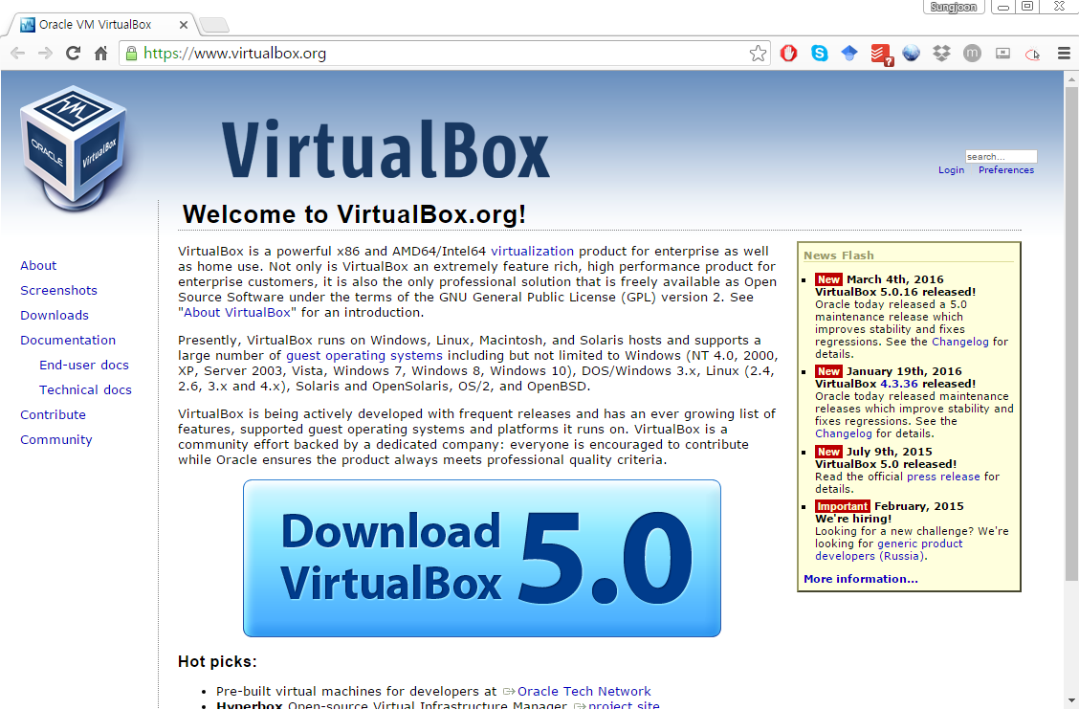
VirtualBox
https://www.virtualbox.org/

Slide 3
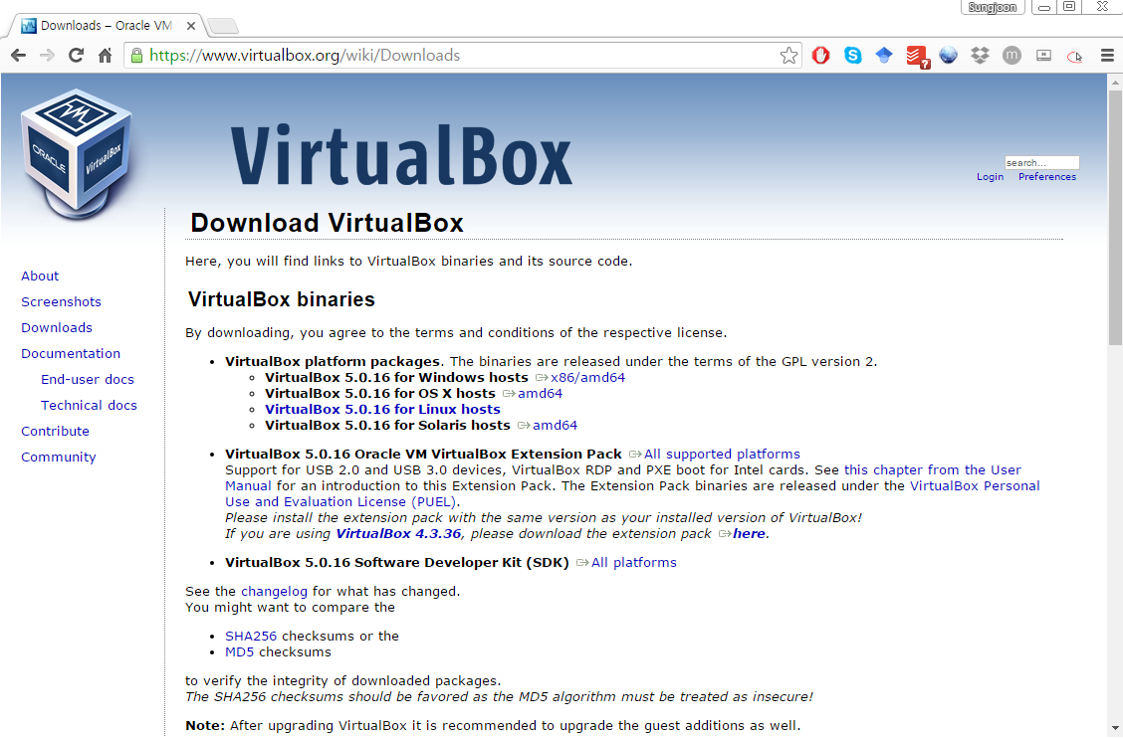
VirtualBox

Slide 4
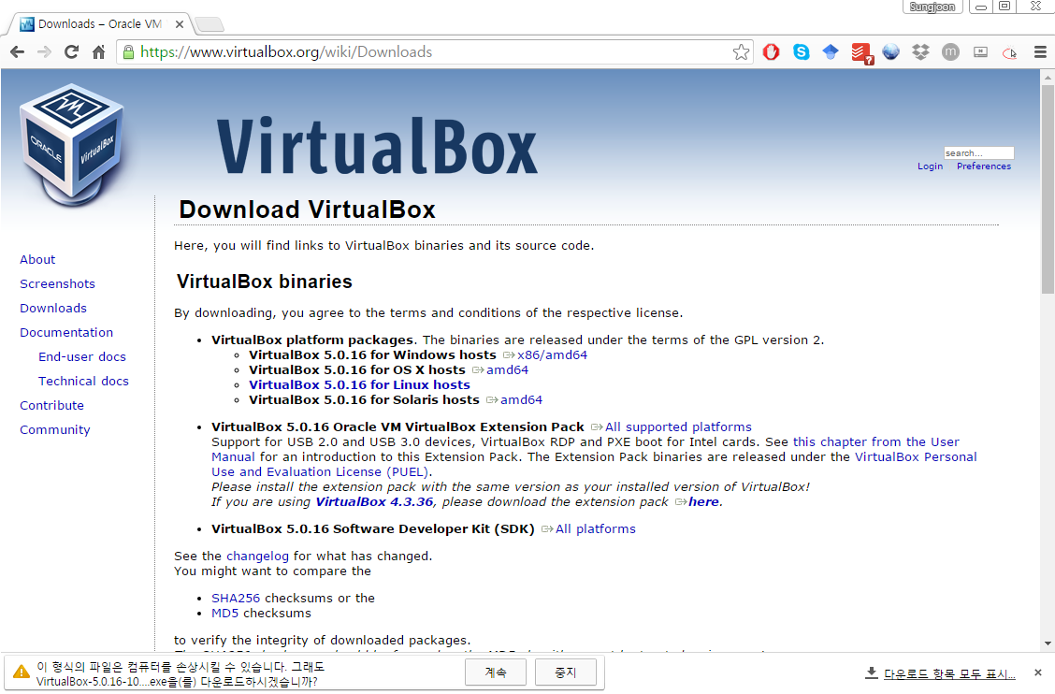
VirtualBox

Slide 5
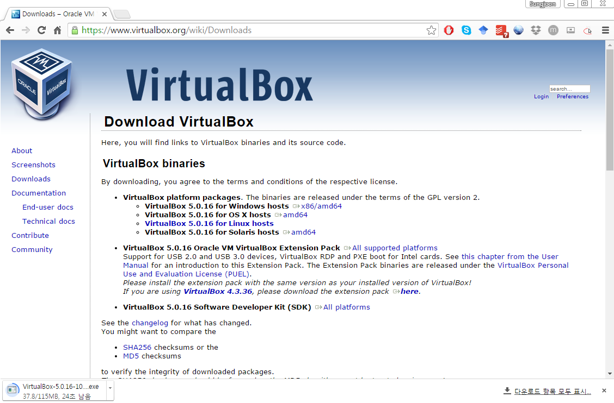
VirtualBox

Slide 6
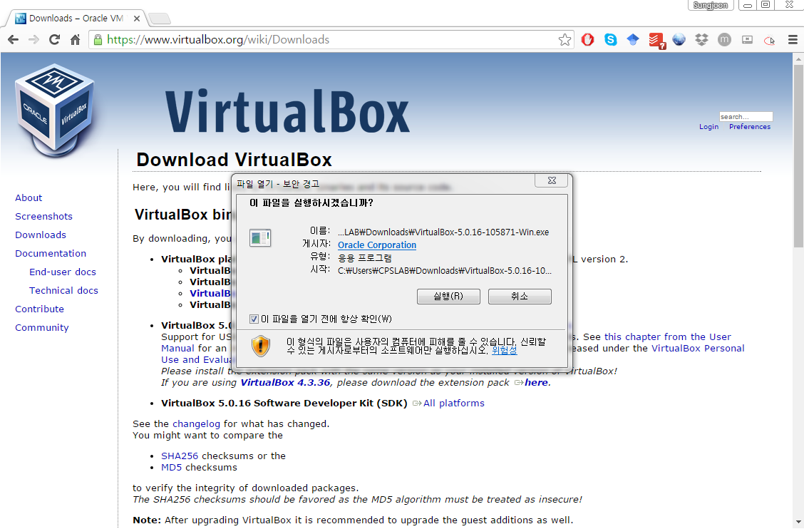
VirtualBox

Slide 7
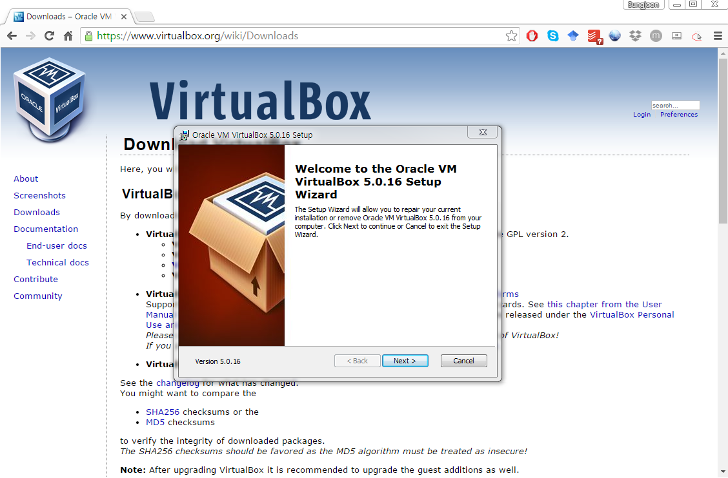
VirtualBox

Slide 8
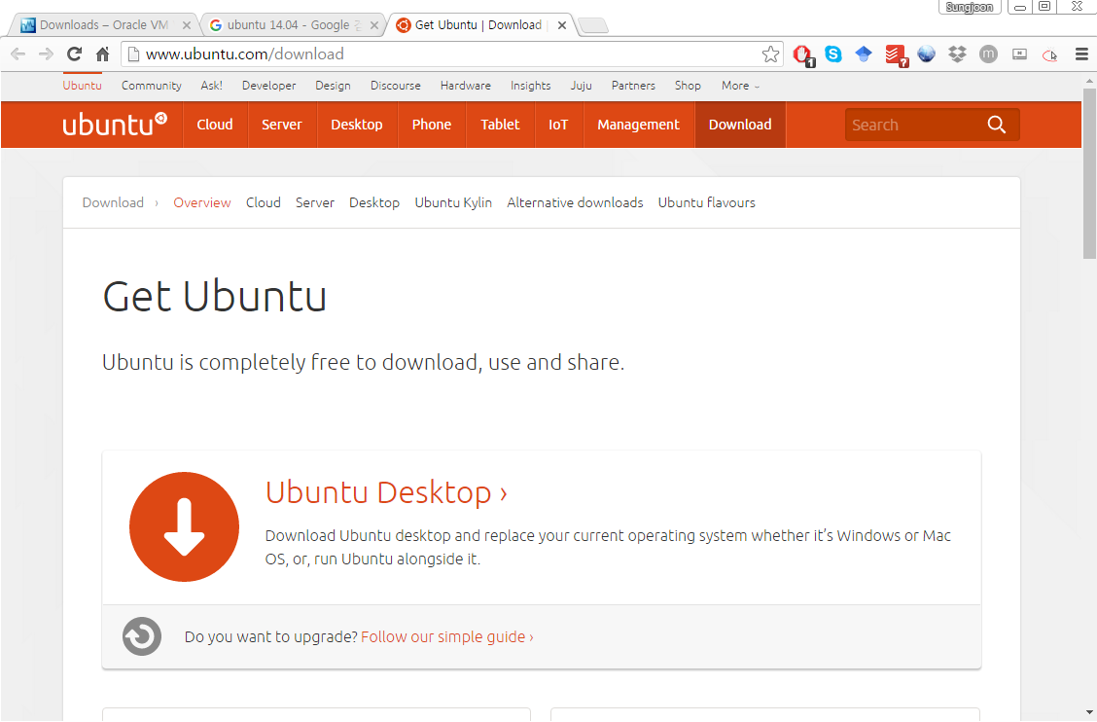
Download Ubuntu
http://www.ubuntu.com/download

Slide 9
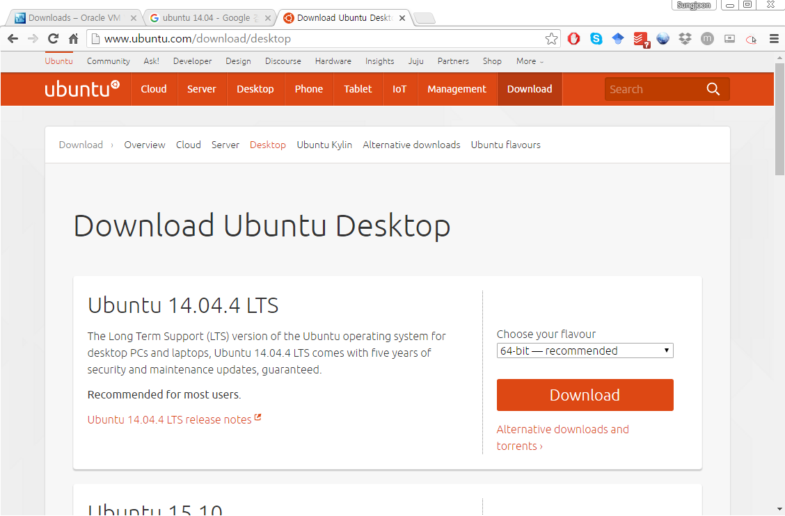
Download Ubuntu

Slide 10
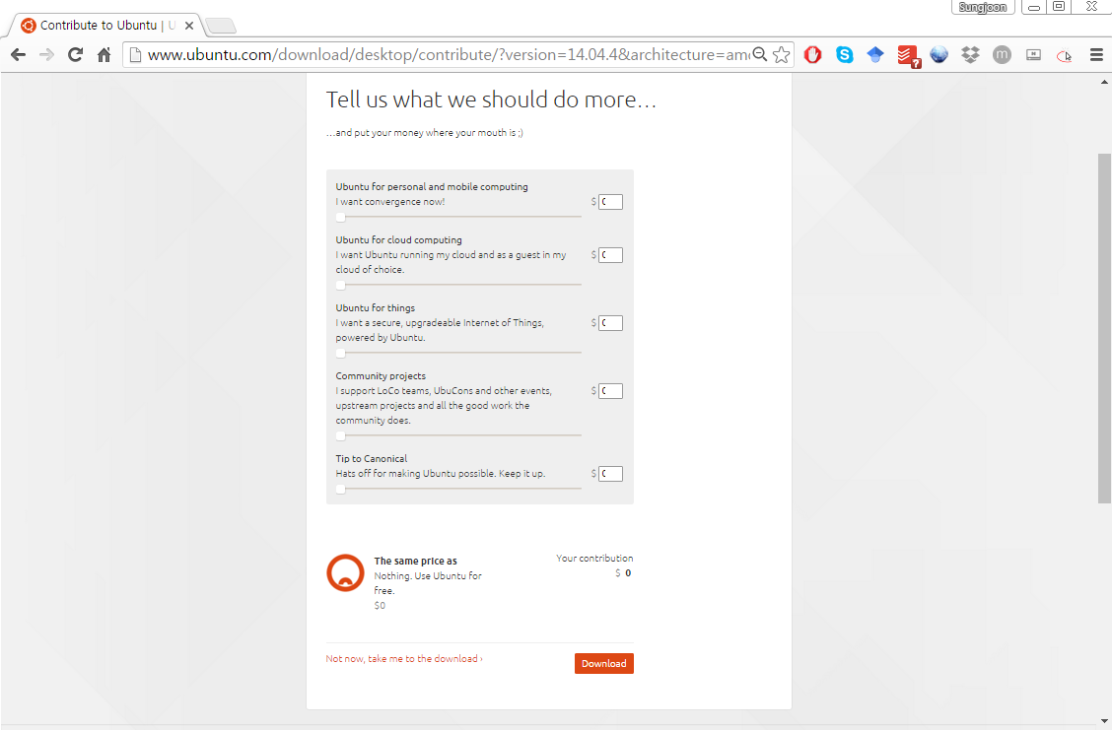
Download Ubuntu

Slide 11
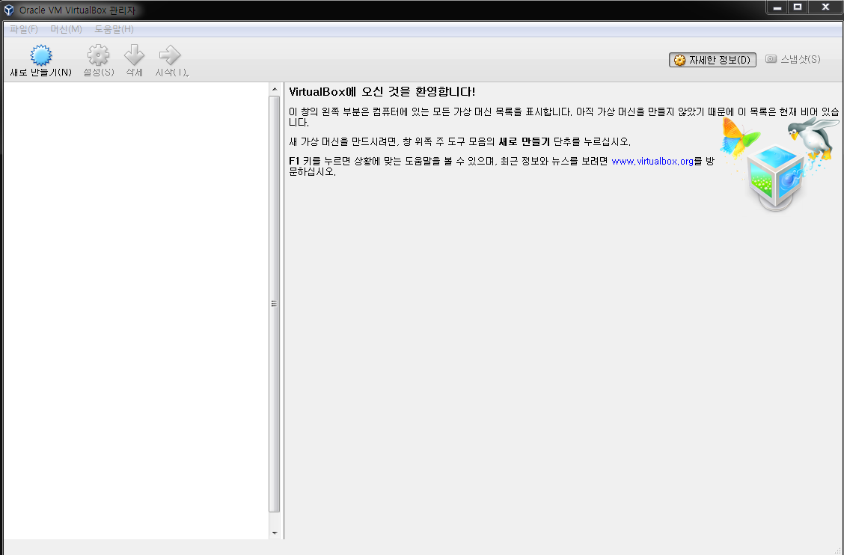
Install Ubuntu on VirtualBox

Slide 12
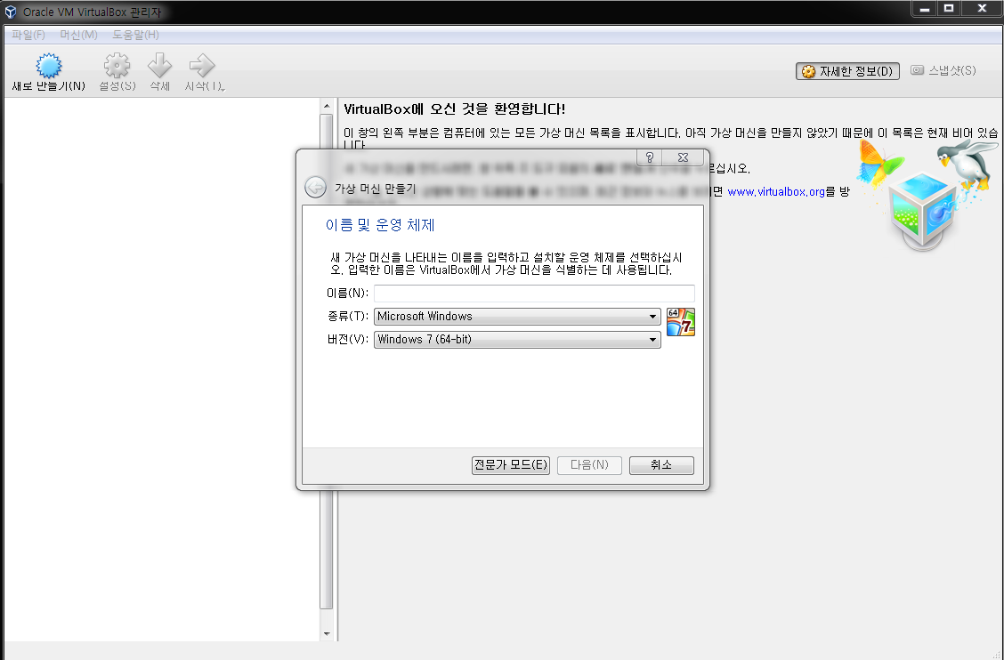
Install Ubuntu on VirtualBox

Slide 13
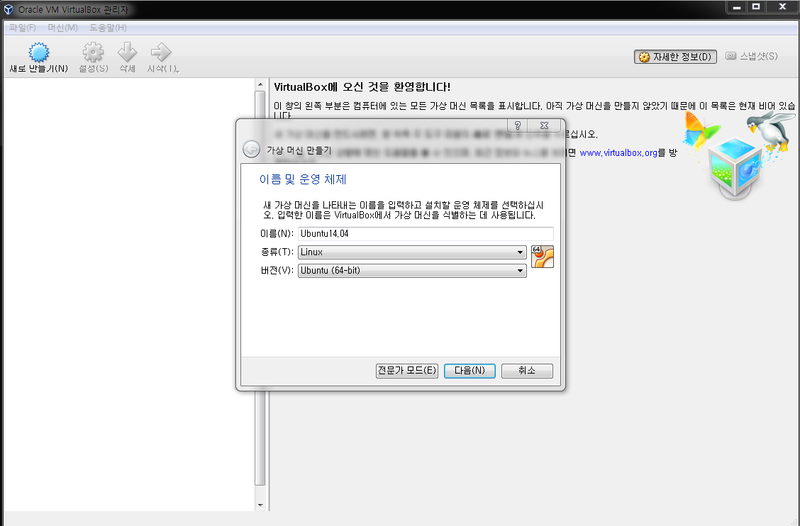
Install Ubuntu on VirtualBox

Slide 14
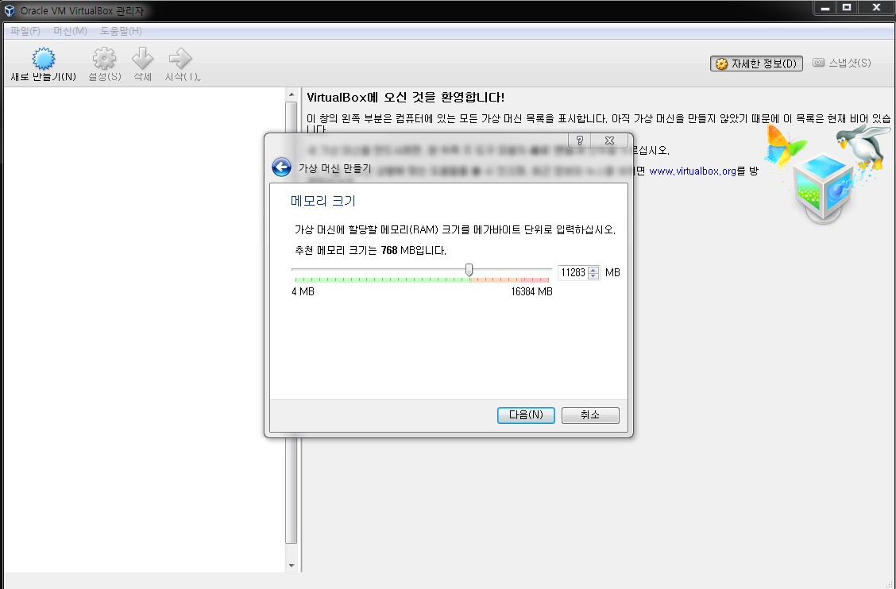
Install Ubuntu on VirtualBox

Slide 15
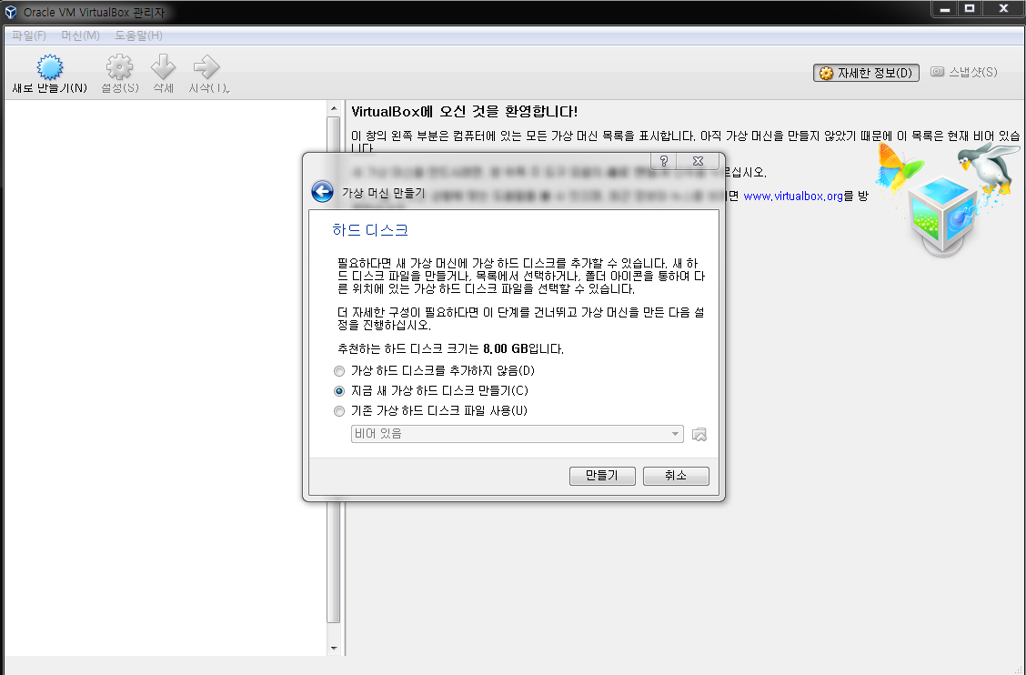
Install Ubuntu on VirtualBox

Slide 16
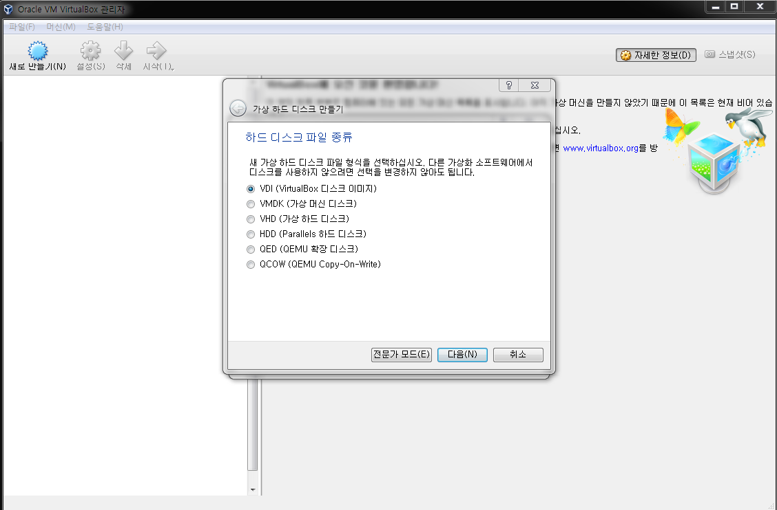
Install Ubuntu on VirtualBox

Slide 17
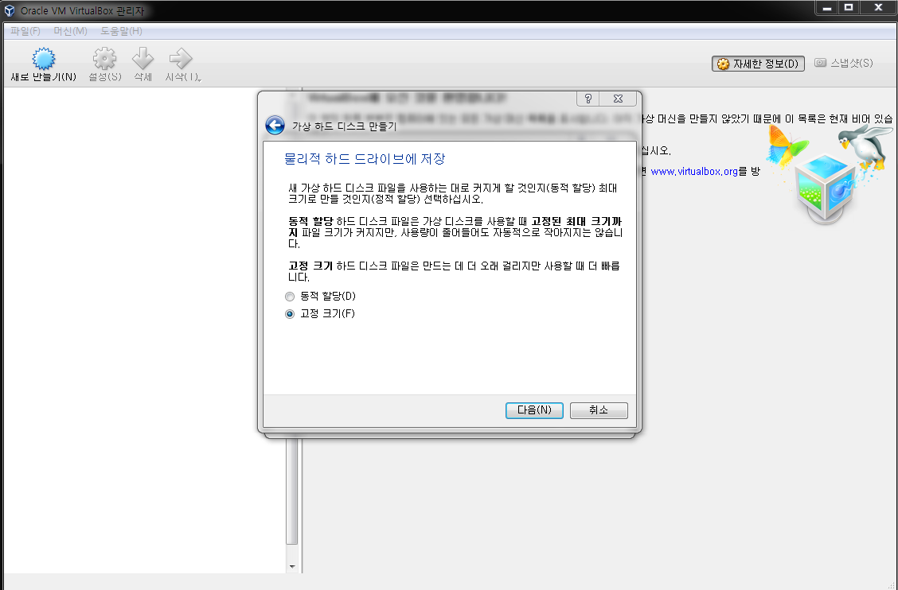
Install Ubuntu on VirtualBox

Slide 18
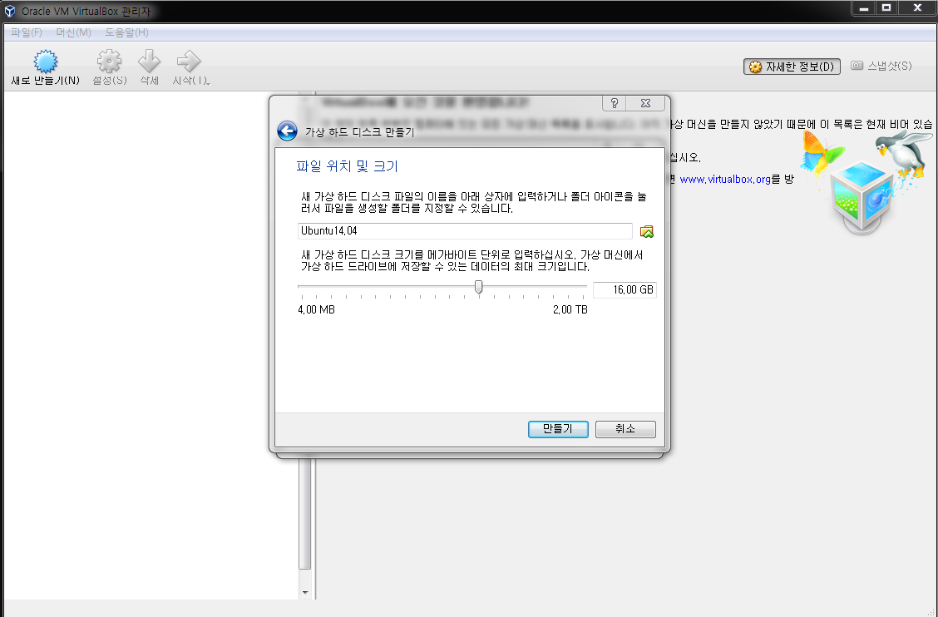
Install Ubuntu on VirtualBox
Change the path, if you want.
At least 32GB! I did 64GB.

Slide 19
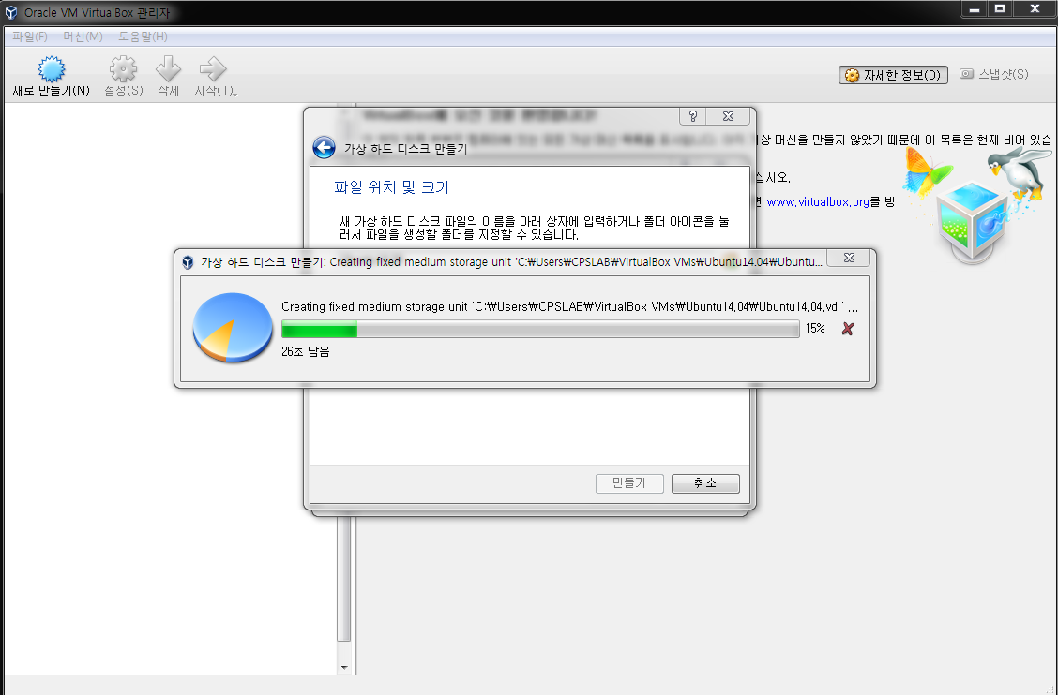
Install Ubuntu on VirtualBox

Slide 20
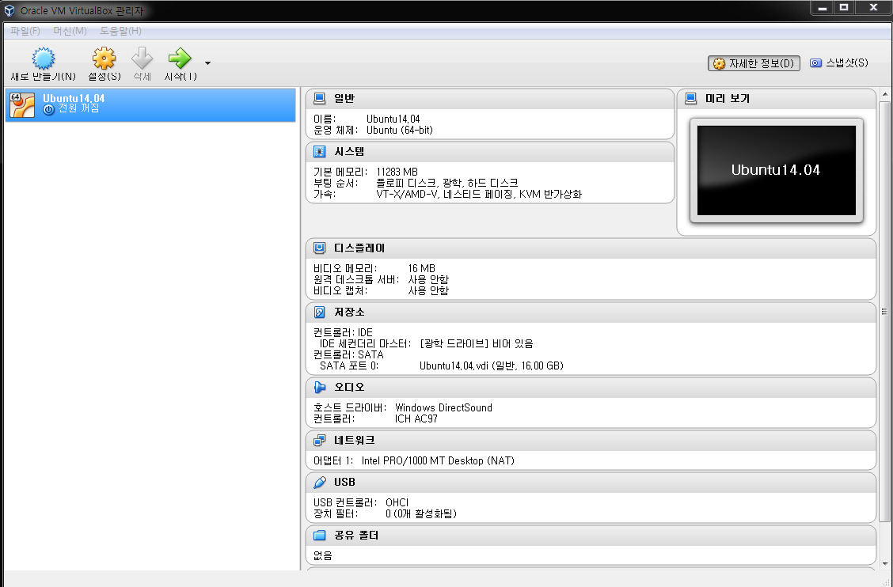
Install Ubuntu on VirtualBox

Slide 21
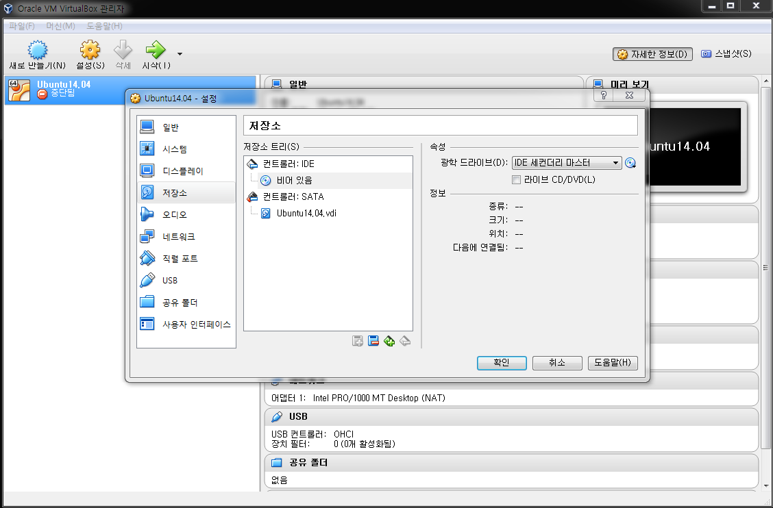
Install Ubuntu on VirtualBox

Slide 22
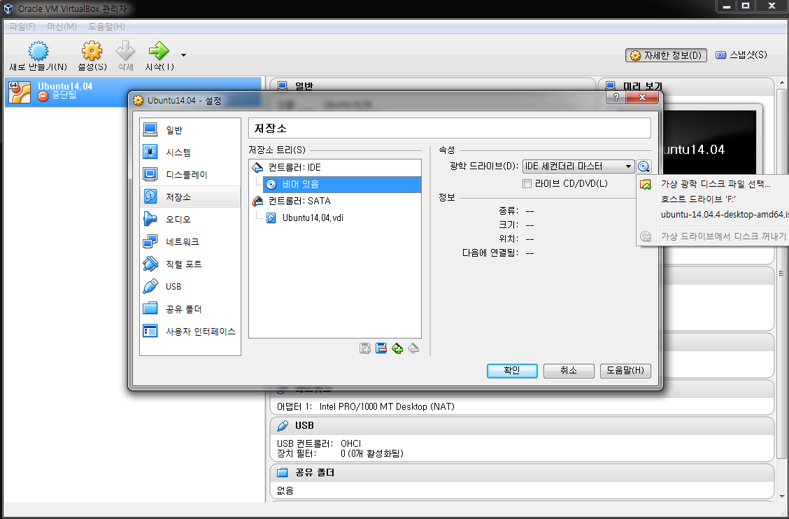
Install Ubuntu on VirtualBox

Slide 23
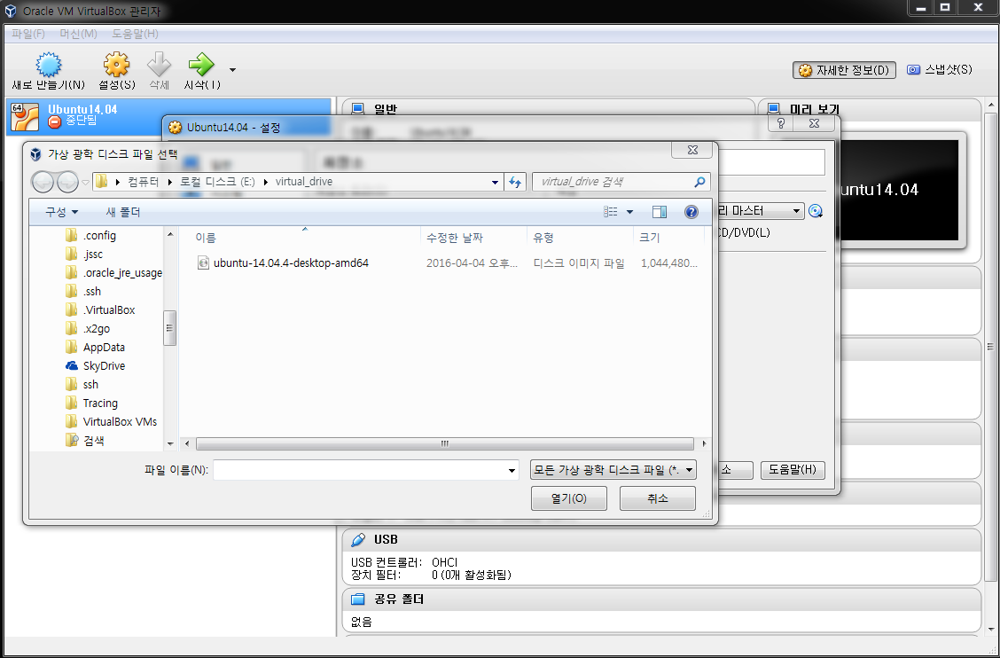
Install Ubuntu on VirtualBox

Slide 24
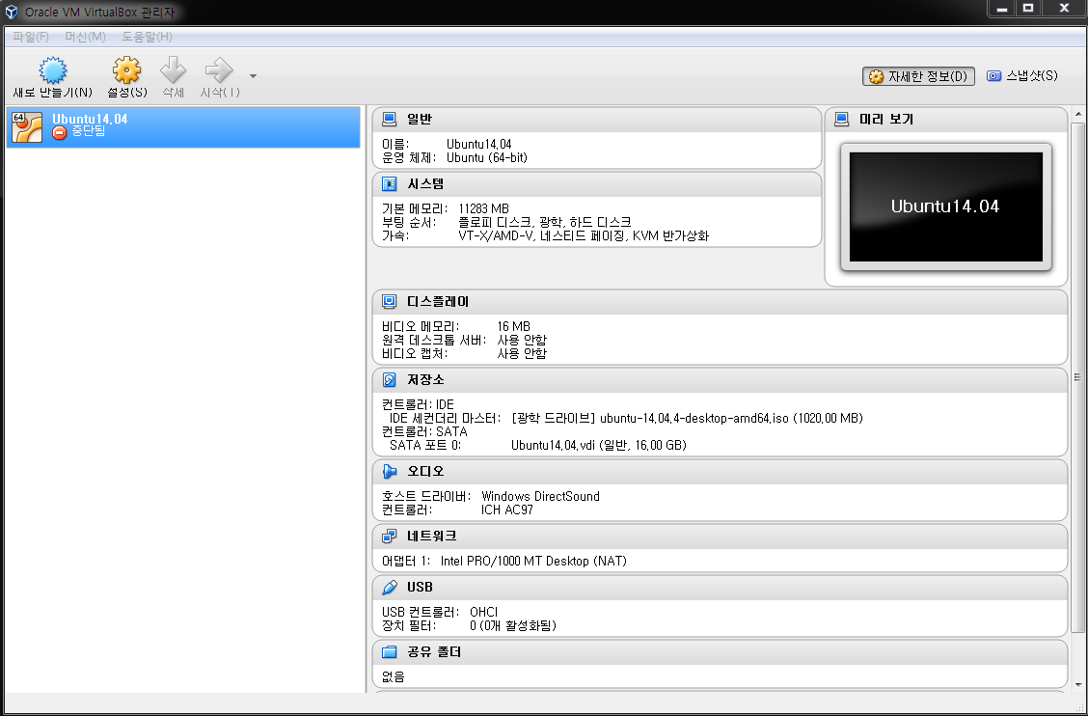
Install Ubuntu on VirtualBox

Slide 25
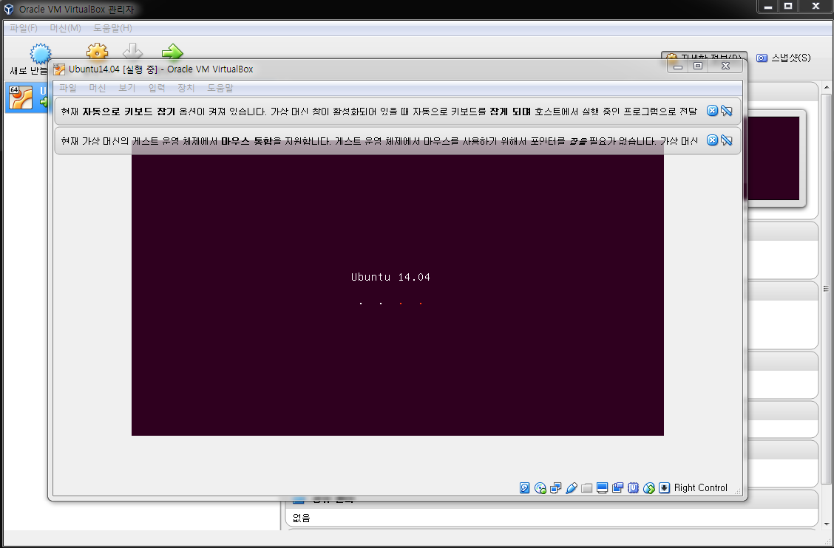
Install Ubuntu on VirtualBox

Slide 26
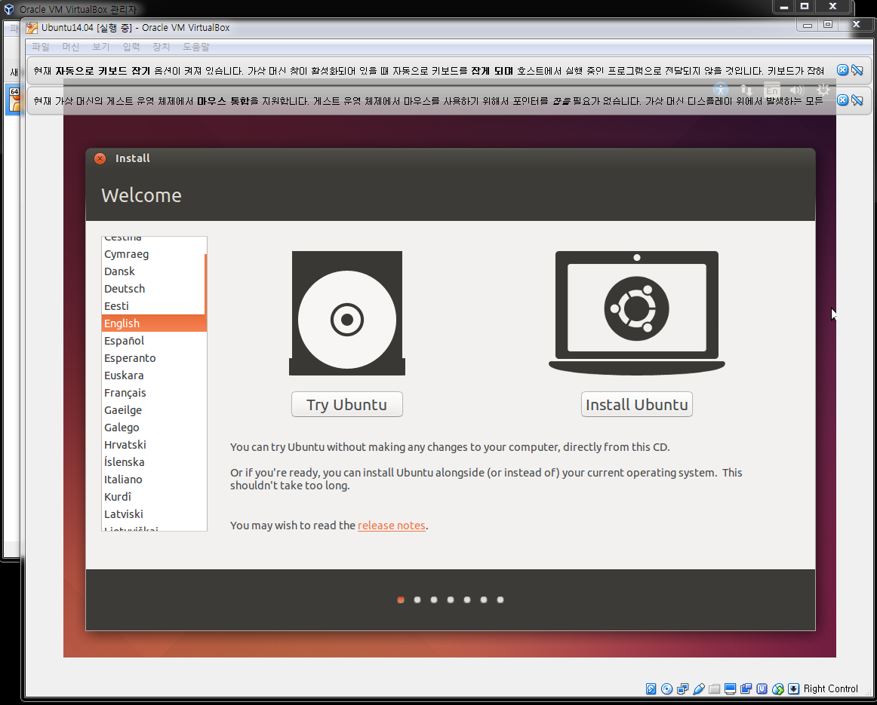
Install Ubuntu on VirtualBox

Slide 27
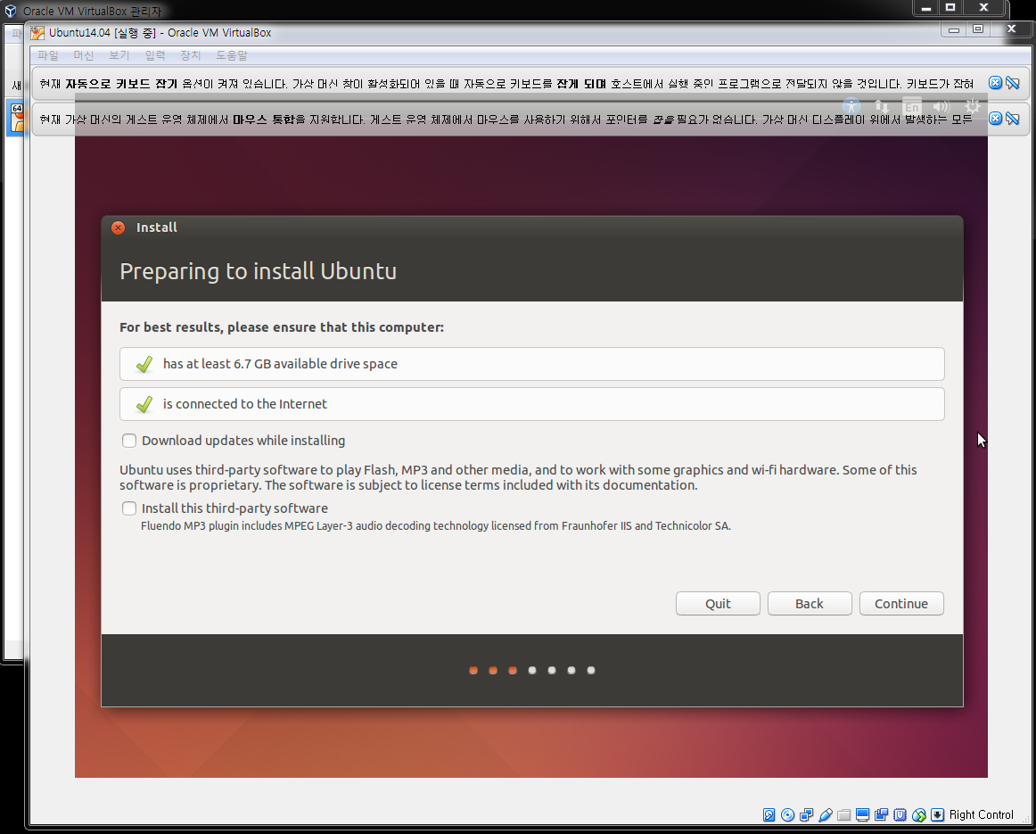
Install Ubuntu on VirtualBox

Slide 28
Install Ubuntu on VirtualBox

Slide 29
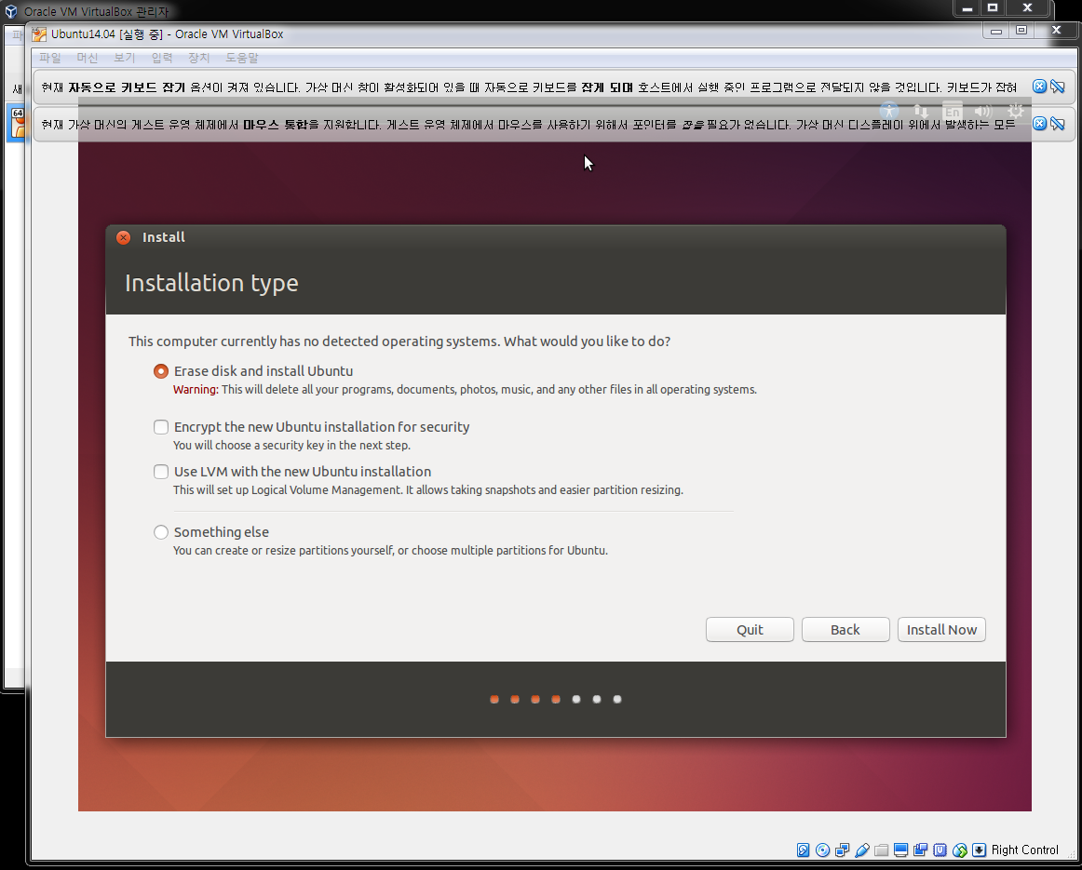
Install Ubuntu on VirtualBox

Slide 30
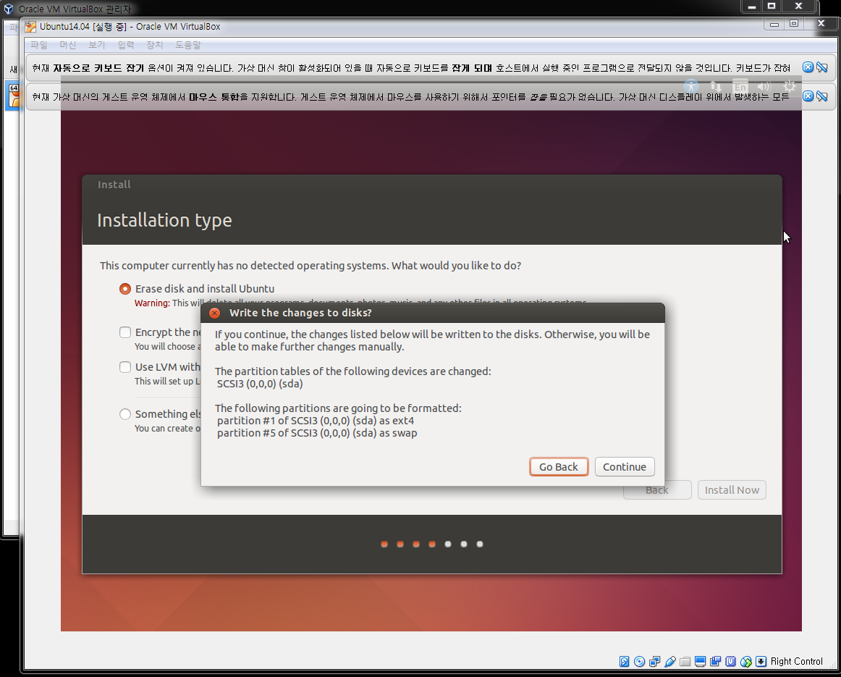
Install Ubuntu on VirtualBox

Slide 31
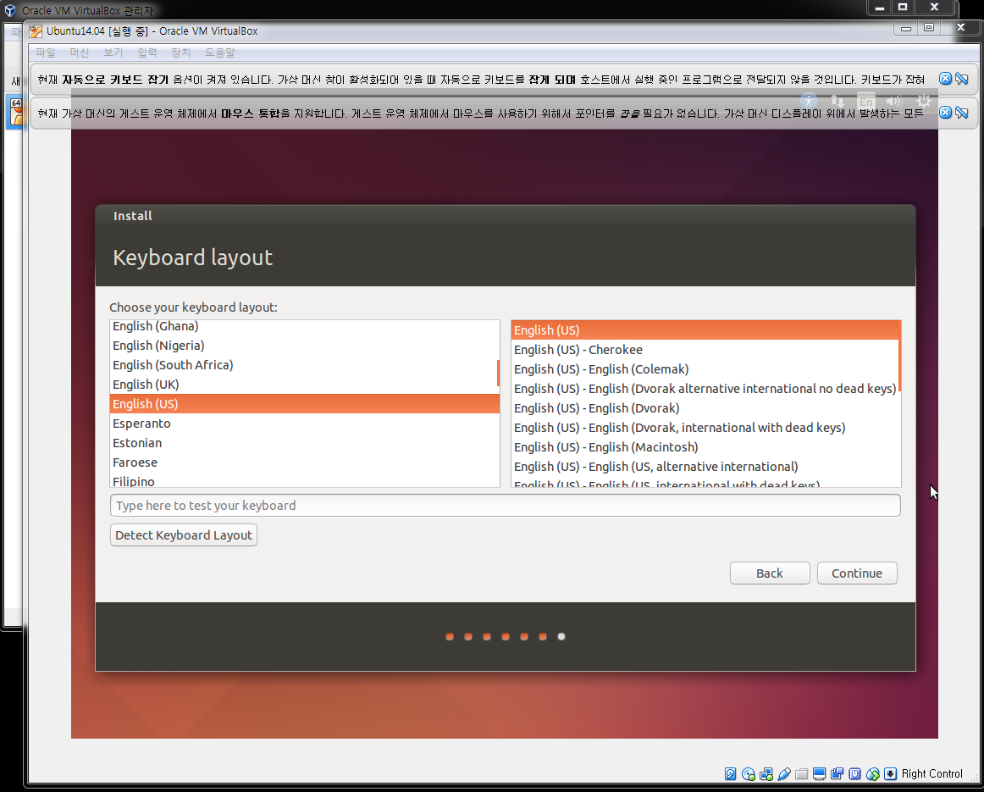
Install Ubuntu on VirtualBox

Slide 32
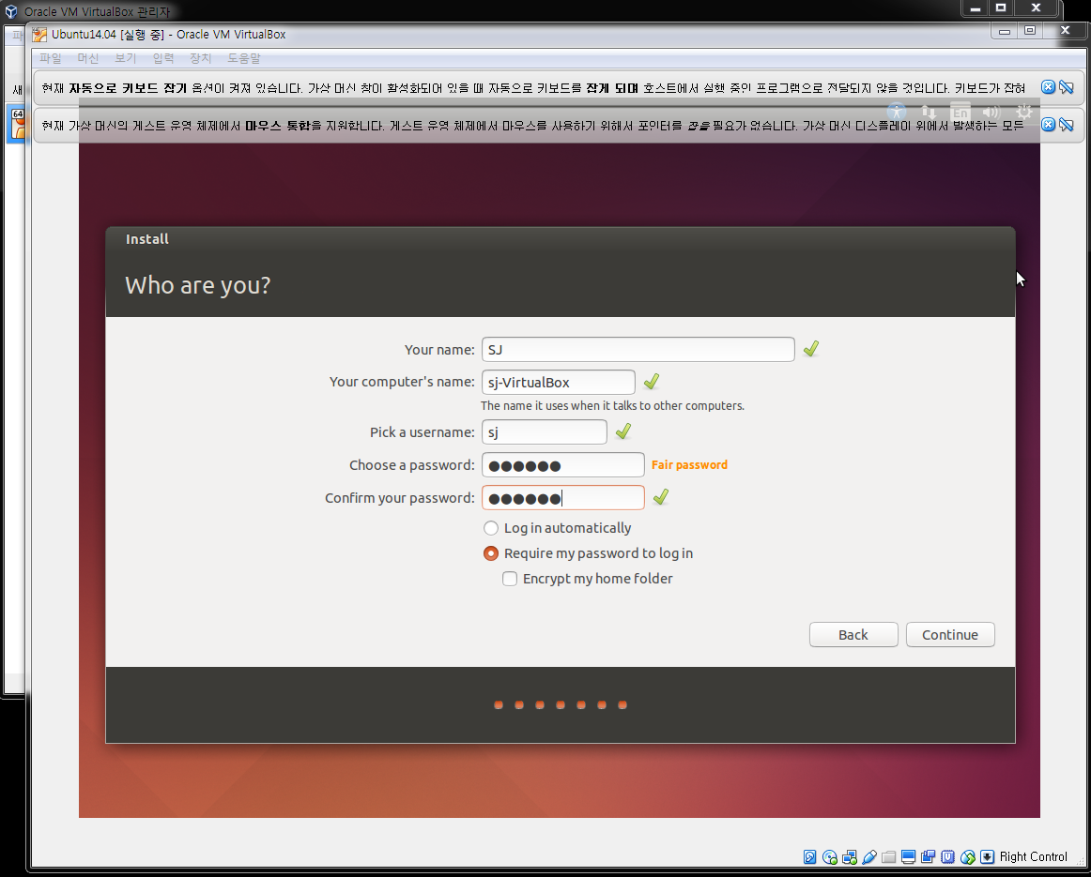
Install Ubuntu on VirtualBox

Slide 33
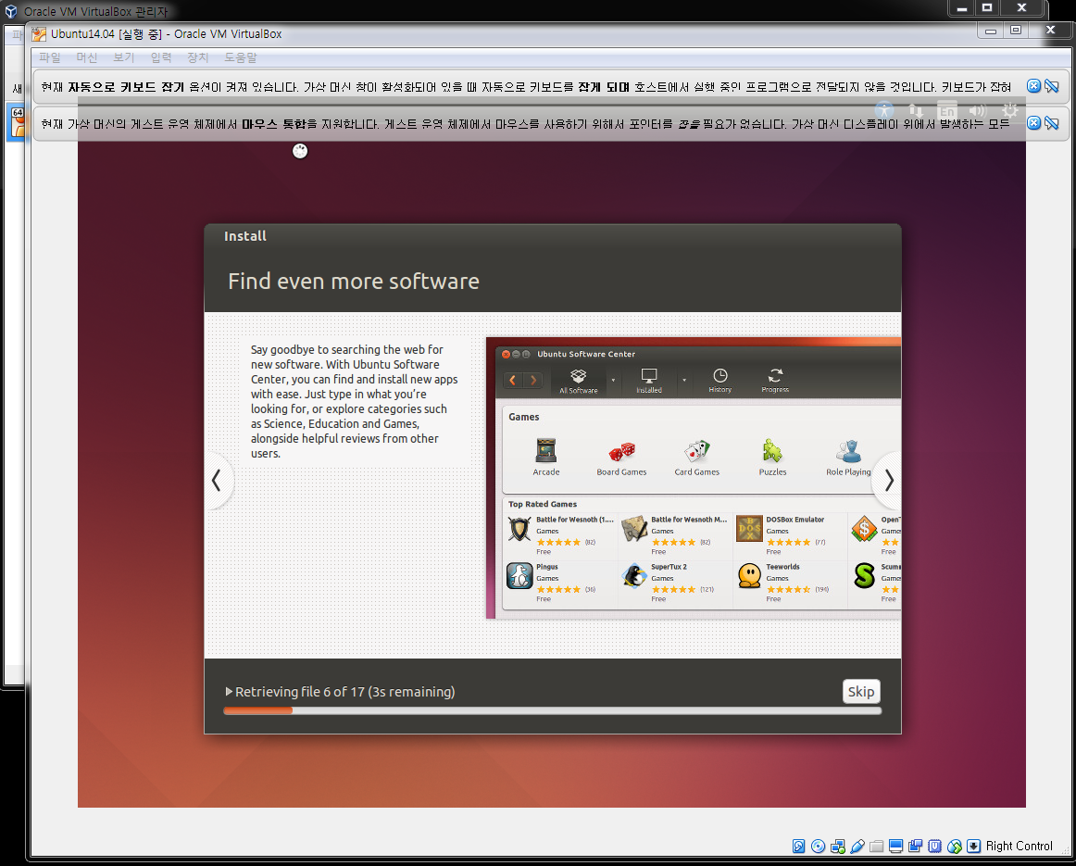
Install Ubuntu on VirtualBox

Slide 34
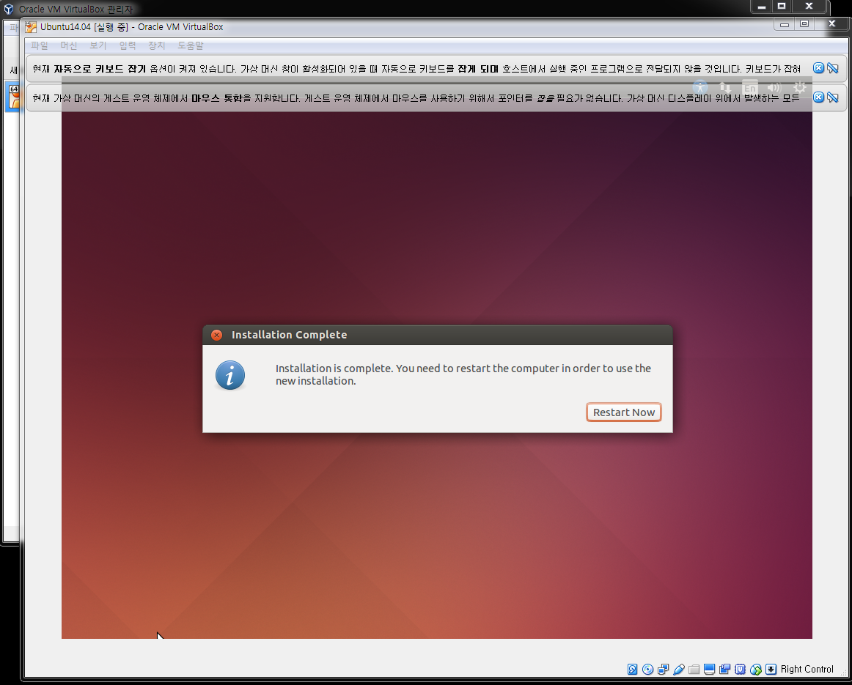
Install Ubuntu on VirtualBox

Slide 35
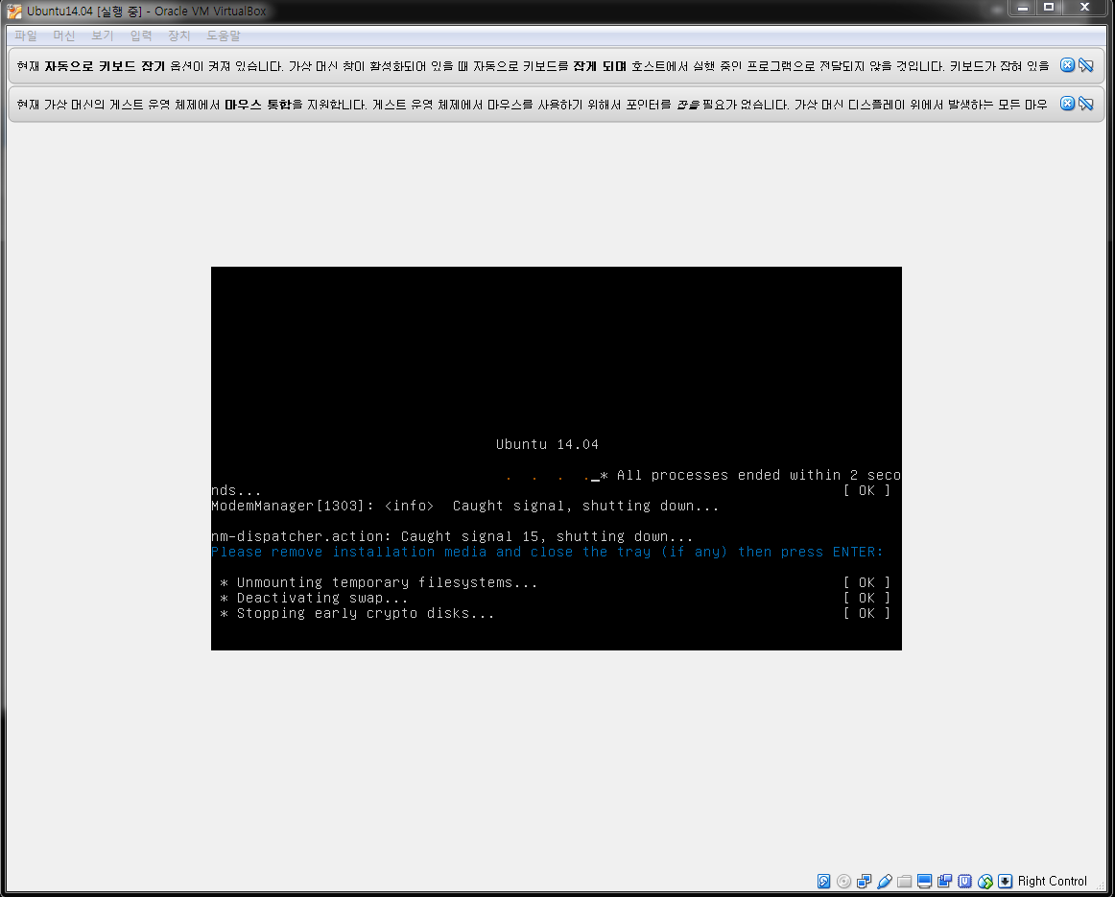
Install Ubuntu on VirtualBox
Wait!!! and then Press Enter!

Slide 36
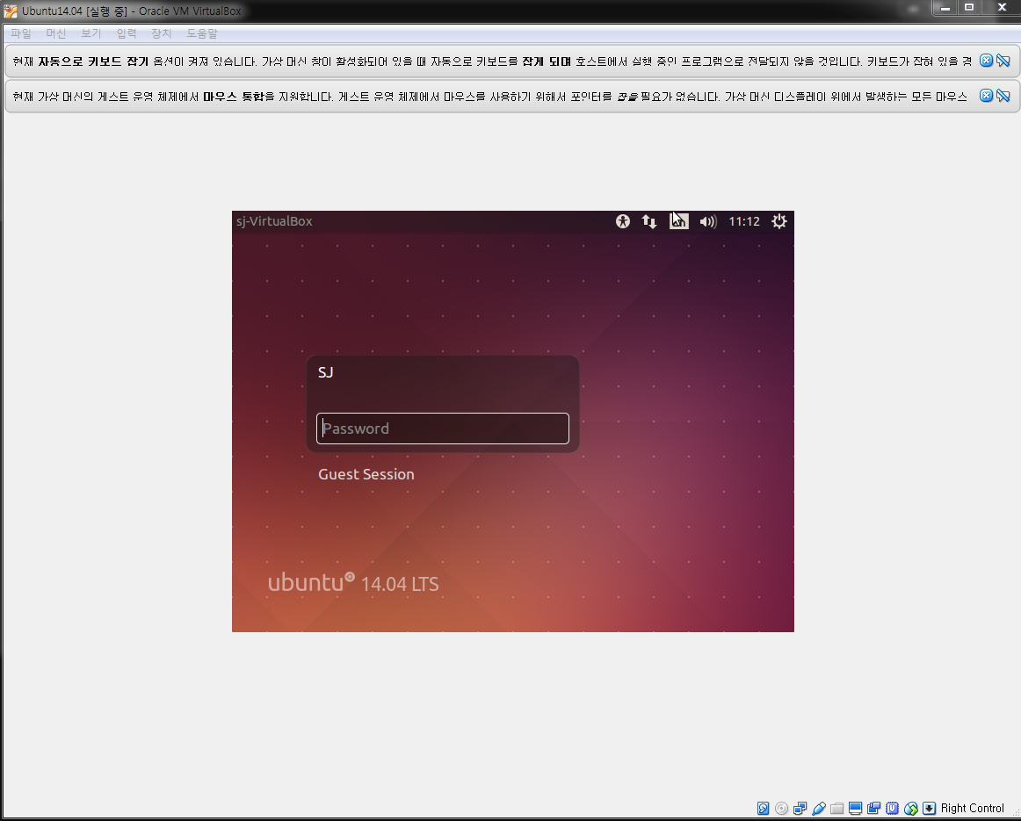
Install Ubuntu on VirtualBox

Slide 37
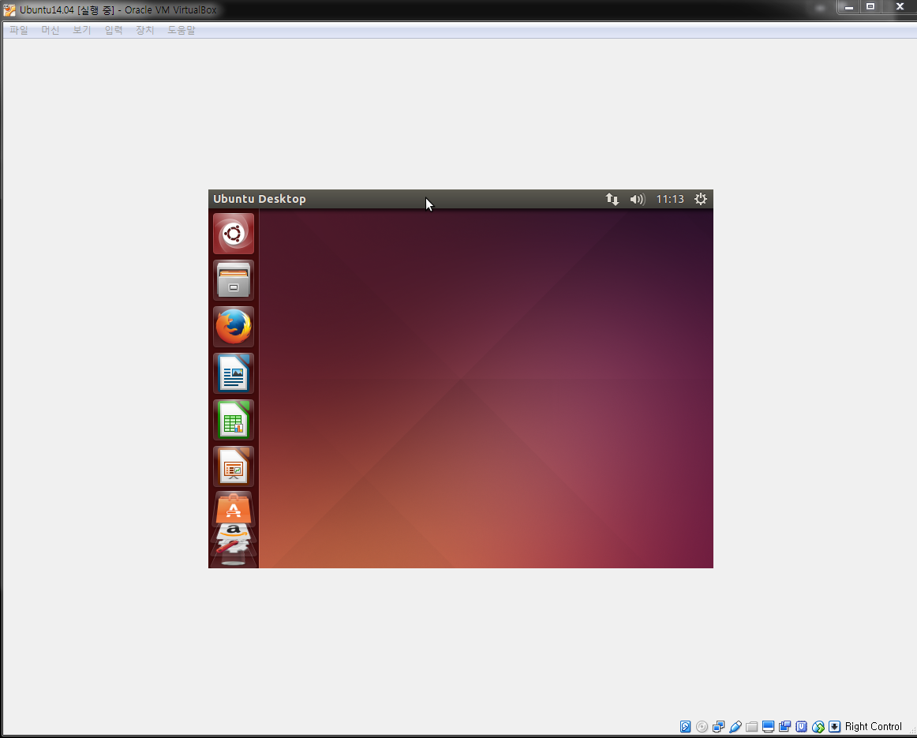
Install Ubuntu on VirtualBox

Slide 38
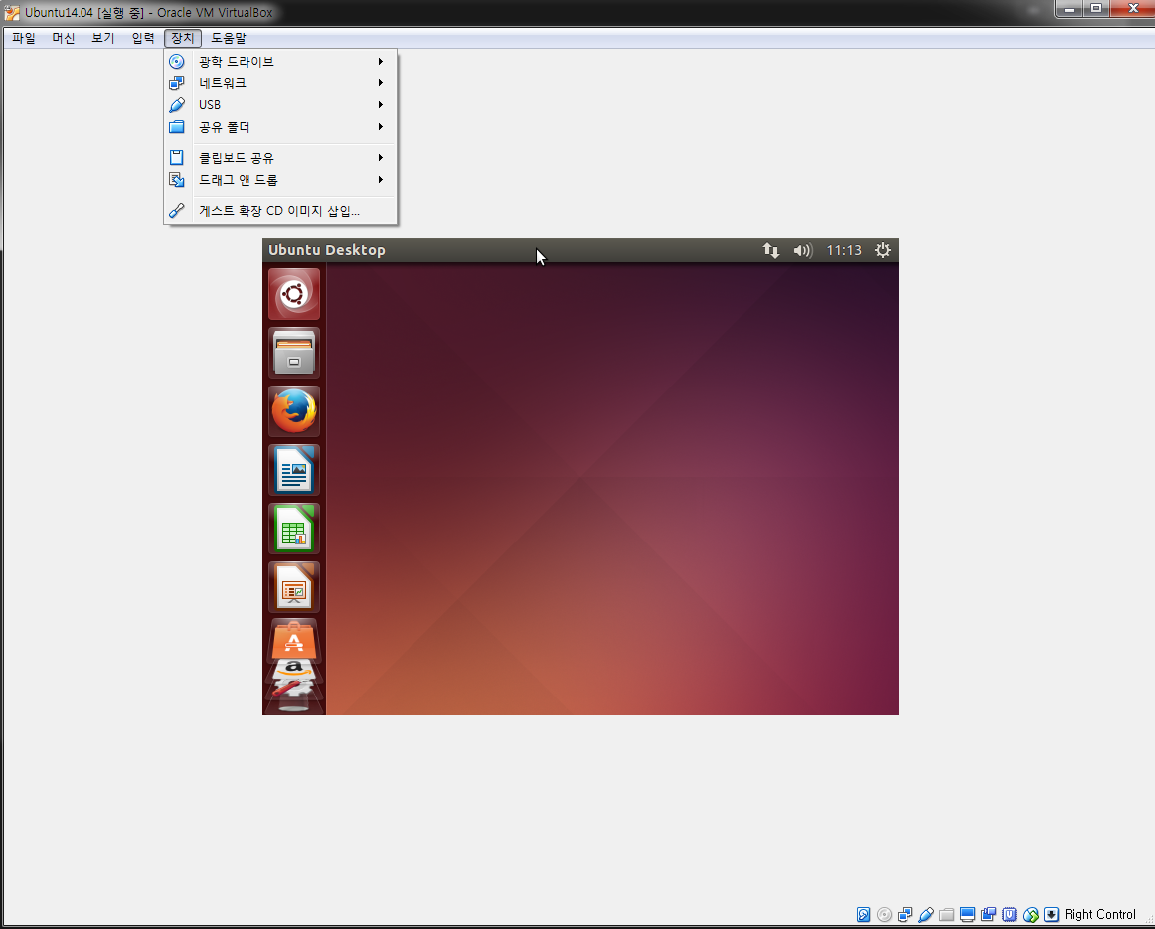
Install Ubuntu on VirtualBox

Slide 39
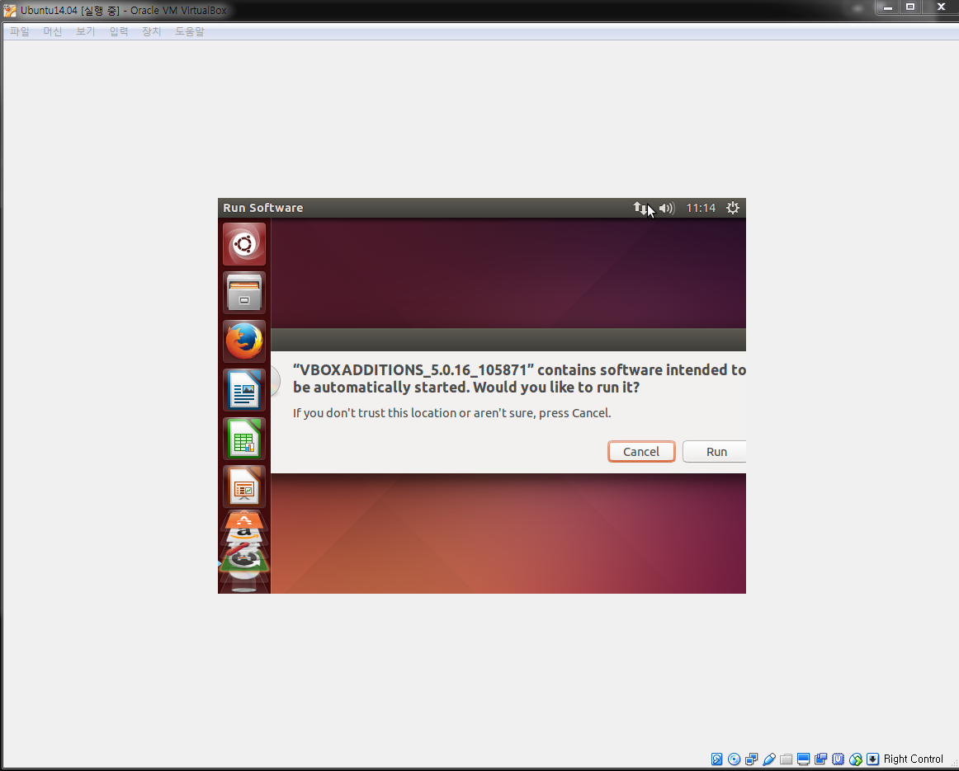
Install Ubuntu on VirtualBox

Slide 40
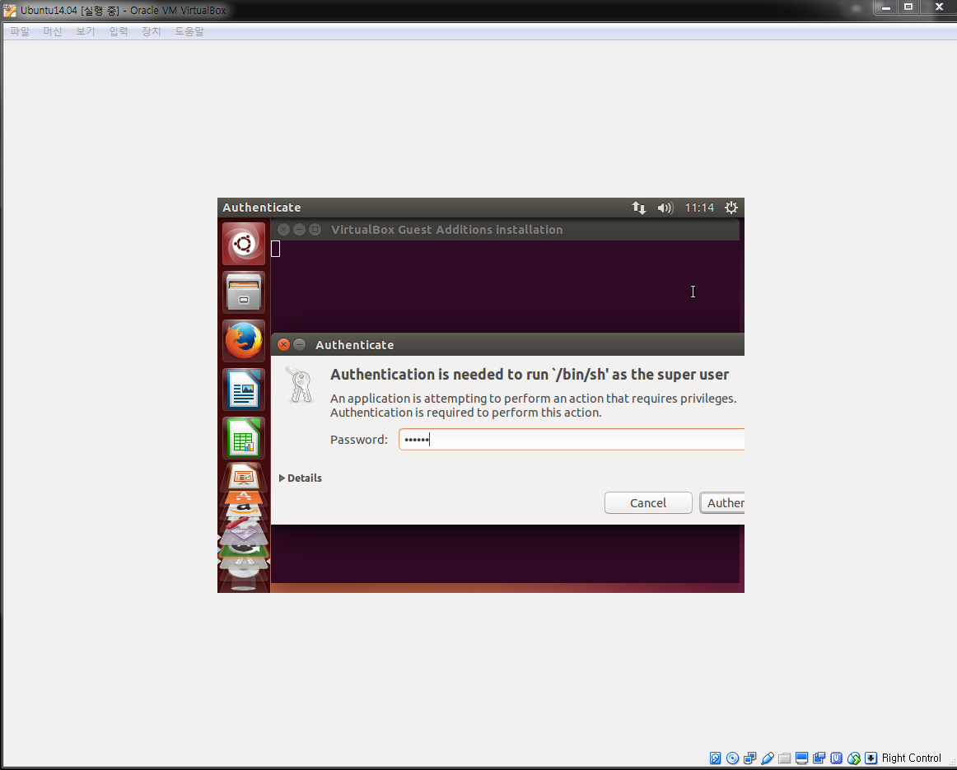
Install Ubuntu on VirtualBox

Slide 41
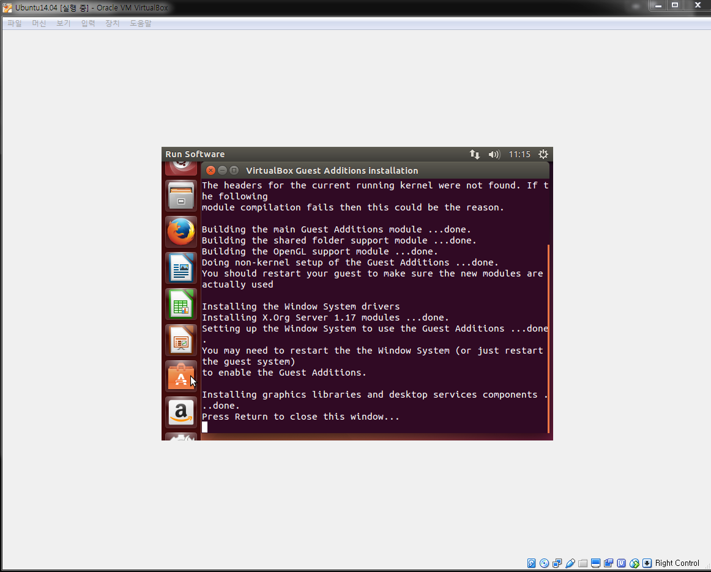
Install Ubuntu on VirtualBox
Press Enter!

Slide 42
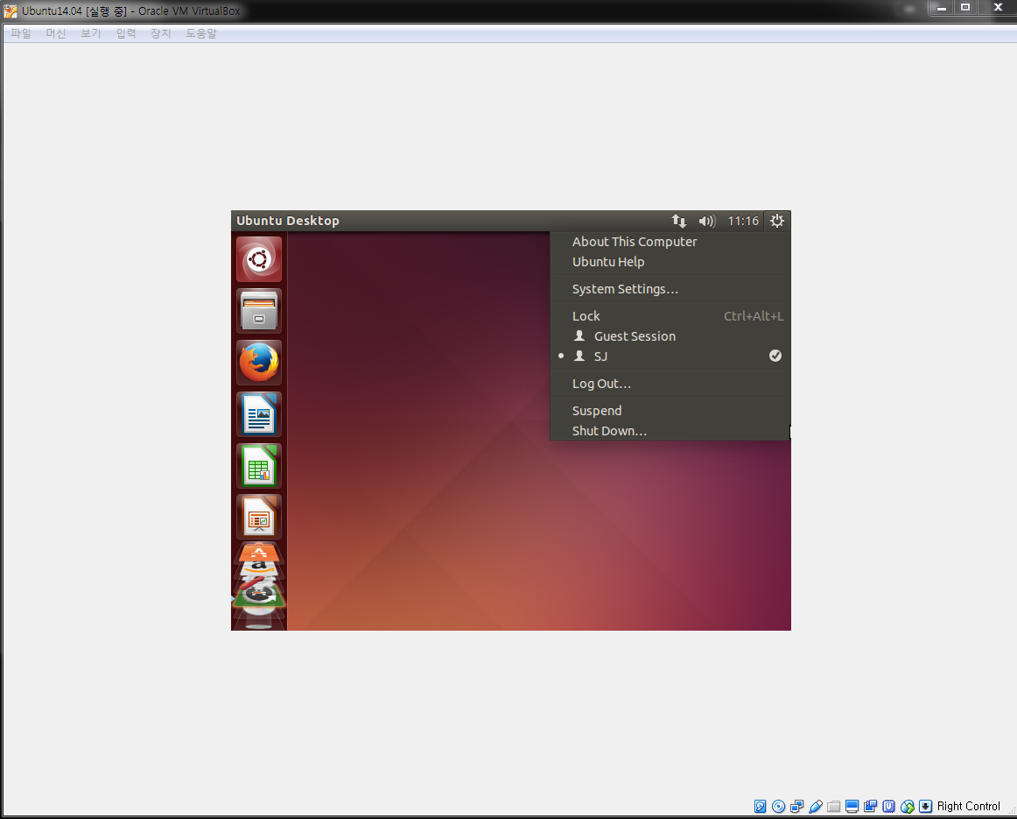
Install Ubuntu on VirtualBox

Slide 43
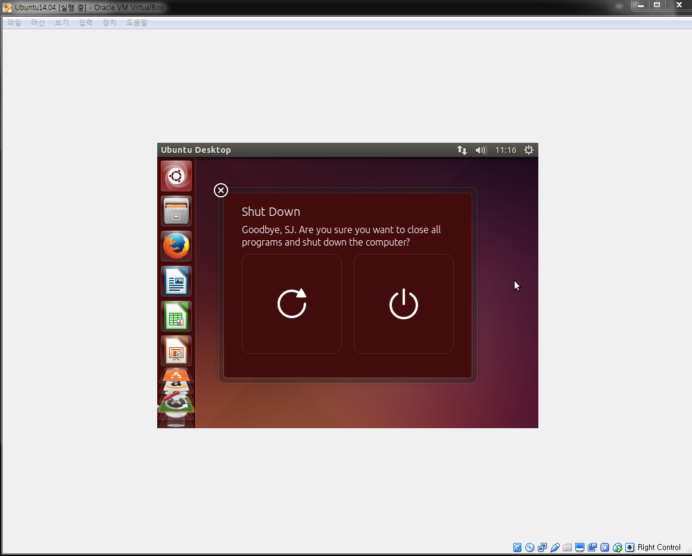
Install Ubuntu on VirtualBox

Slide 44
Install Ubuntu on VirtualBox
Rerun, and we get wider screen.

Slide 45
Install Ubuntu on VirtualBox

Slide 46
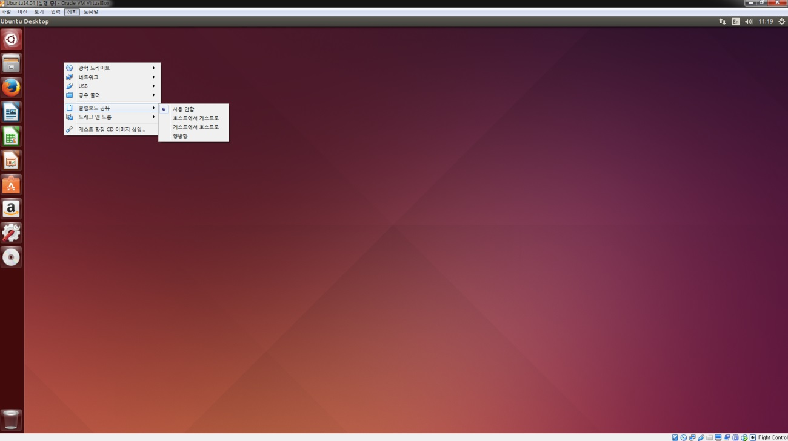
Install Ubuntu on VirtualBox
To enable copy and paste.

Slide 47
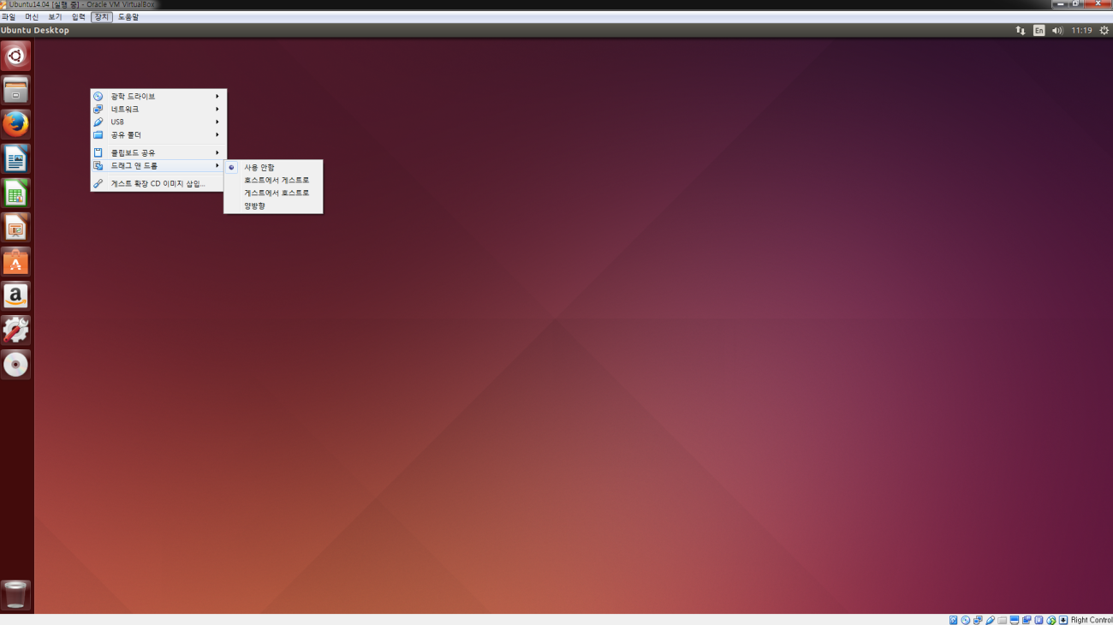
Install Ubuntu on VirtualBox

